Slide 1
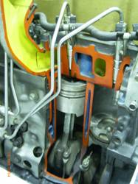
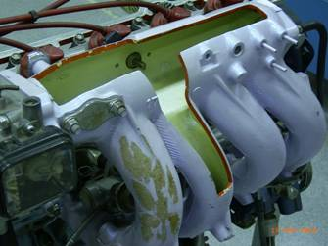
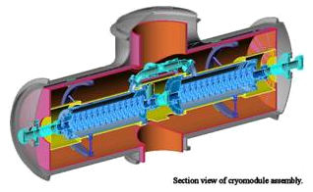
Chapter 10
Conventional Practice
in Section View

Slide 2
TOPICS
Section view representation
of rib, web, spoke and lug.
Aligned section
Conventional break

Slide 3

Section view representation of
rib, web, spoke and lug

Slide 4
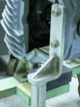
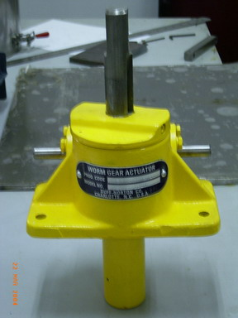
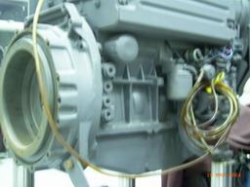
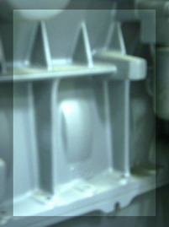
TERMINOLOGY
Rib and Web are thin, flat feature of an object that acts as a structural support.
Web
Rib
Rib

Slide 5
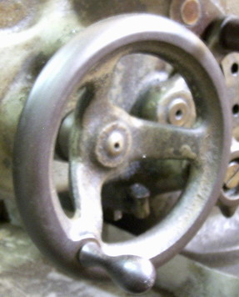
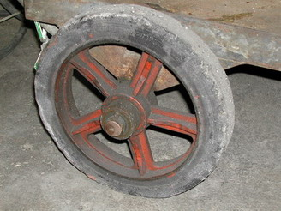
TERMINOLOGY
Spoke is the rod radiating from the hub to the rim of a wheel.
Hub
Hub
Spoke
Rim
Spoke
Rim

Slide 6
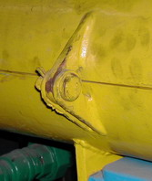
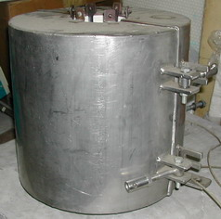
TERMINOLOGY
Lug is an ear which is built as portion of an object for attachment.

Slide 7
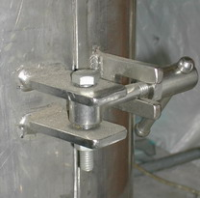
TERMINOLOGY
Lug is an ear which is built as portion of an object for attachment.

Slide 8
CONVENTIONAL PRACTICE
Omit the section lines on the section view of
Rib, Web and Lug, if the cutting plane is
passed flatwise through.
Spoke, if the cutting plane is passed longwise
through.

Slide 9
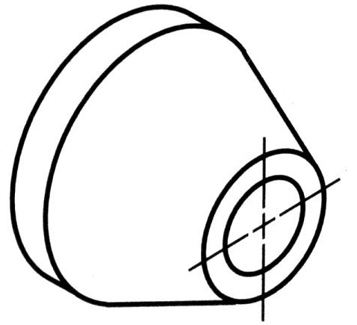
EXAMPLE : RIB
Normal multiview drawing
Normal section view
Section view drawing with convention

Slide 10
EXAMPLE : WEB : flatwise cut
Normal multiview drawing
Normal section view
Section view drawing with convention

Slide 11
EXAMPLE : WEB : crosswise cut

Slide 12
EXAMPLE : WEB : multiple section view

Slide 13
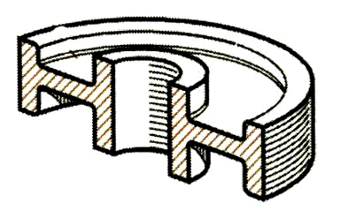
EXAMPLE : SPOKE
Misleading impression

Slide 14
EXAMPLE : LUG

Slide 15
Aligned Section

Slide 16
DEFINITION
Aligned section is a section view that is drawn
by imaginary rotating the object’s features
appeared in a principal view about symmetry
axis

Slide 17
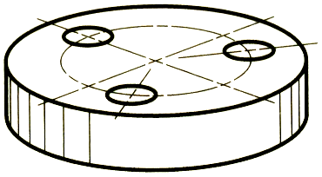
Example : Hole
Gives the impression that this holes are at unsymmetrical position.

Slide 18
Example : Hole

Slide 19
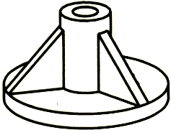
Example : Rib

Slide 20
Example : Ribs & Holes

Slide 21
Example : Spoke & Keyway
Example : Aligned section of keyway

Slide 22
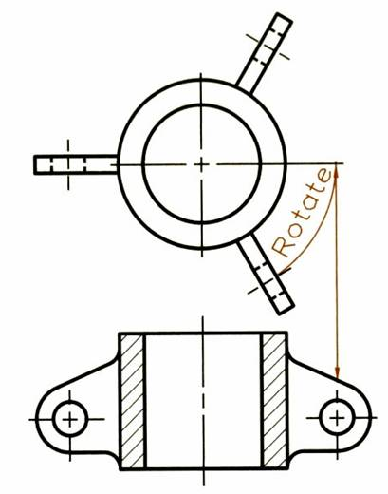
Example : Lug

Slide 23
Conventional Break

Slide 24
CONVENTIONAL PRACTICE
For long objects that have to draw in a small scale to fit them on the paper, it is recommended to remove its long portion (which contains no important information) and draw the break lines at the broken ends.

Slide 25
Example
SCALE 1:1

Slide 26
Example
SCALE 2:1

Slide 27
STANDARD BREAK LINES
Wood
Rectangular
cross section
Metal
Cylindrical
cross section
Tubular
cross section

Slide 28
TO DRAW CYLINDRICAL BREAK
30º
R
30º
R/3
R/3

Slide 29
TO DIMENSION A BROKEN PART
φ16
Typical
dimensioning
method
800
φ16
800
not to scale dimensions

